Slide 1
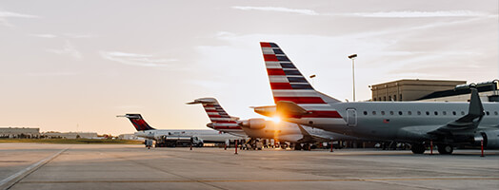
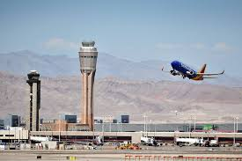
Prediction of Flight Delay
Dream Group:
Andrew Chin
Yang Bai
Uulkan Mamadalieva

Slide 2

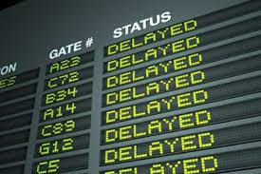
Objective: Prediction of Flight Delay using Machine Learning Model
Background: Flight delays are costing airlines serious money.
Flight delays cost the airline industry $8 billion a year
Delta went from the worst to the best at arriving on-time
Objective: Employing Logistics Regression model to predict Flights Departure Delay

Slide 3
Data Source for Model Creation
Kaggle
2015 Flight Delays and Cancellations:
Flights information
Airlines information
Airports information
Merged Data
Dimension: 5332914 observations and 40 columns
Dependent variable: Departure Delay (1 = Departure Delay, 0 = Departure ontime)
38 Independent variables
Final Data
Random Sampling: Randomly select 25% of the Merged Data

Slide 4
Model Training Process
Feature Engineering (Independent Variables Reduction):
Common sense /Interpretation of the Data
Correlation matrix: Drop variables that are highly correlated with each other
Tableau Visualization to understand correlations (to be introduced next page)
Fitting the Final Data with Logistics Regression Model :
sklearn.linear_model
Pickle to save the model
Divided Final Data into Training Data and Testing Data with equal number of observations
Flask API

Slide 5
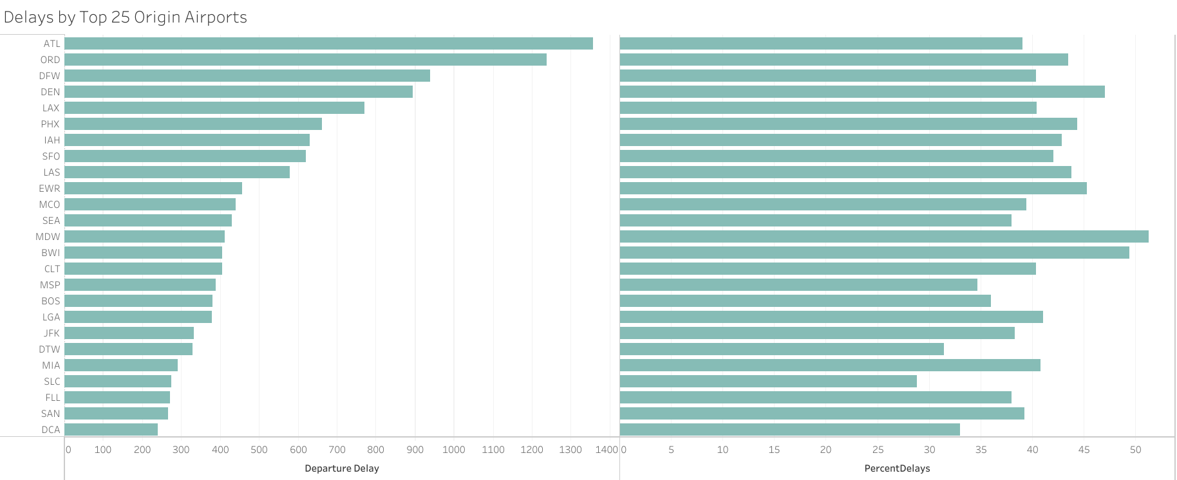
Airport Locations Correlate with Departure Delays

Slide 6
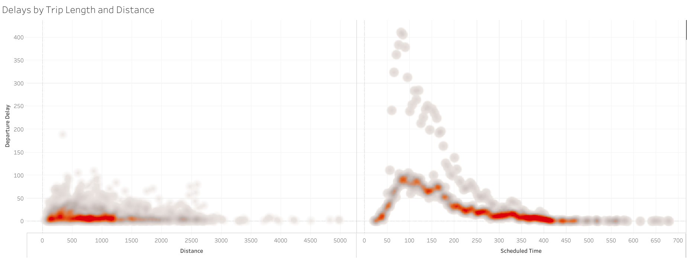
Shorter Trips Correlate with Most Flight Delays

Slide 7
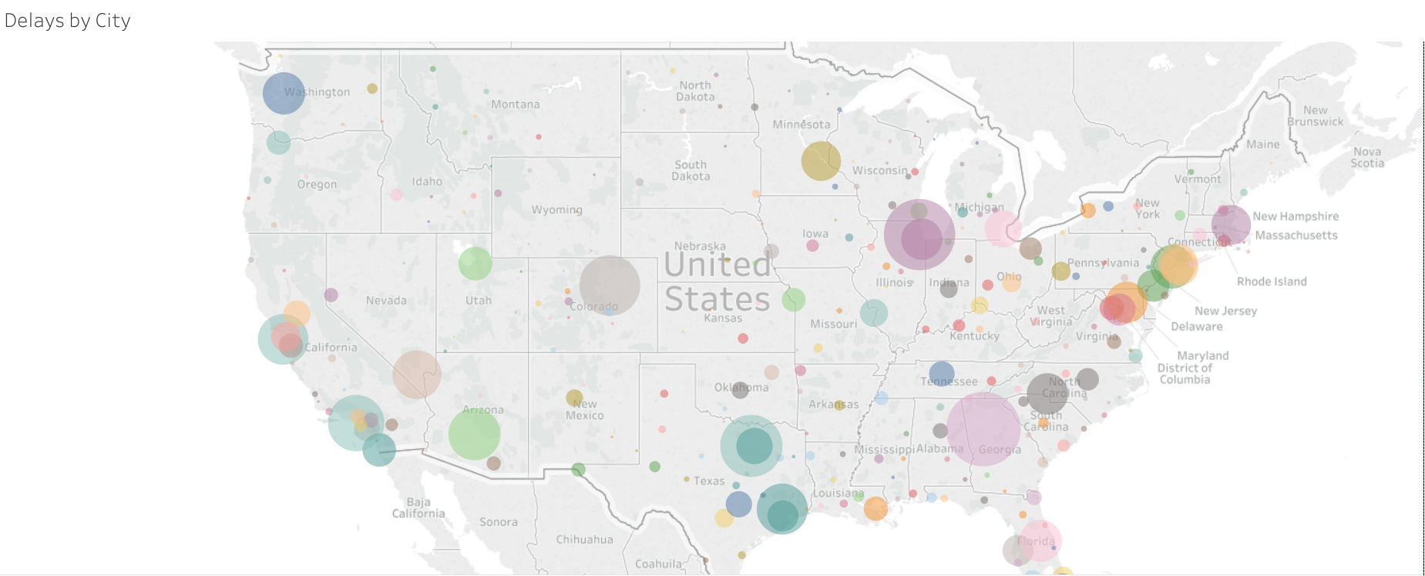
Particular Cities experience more delays than others

Slide 8
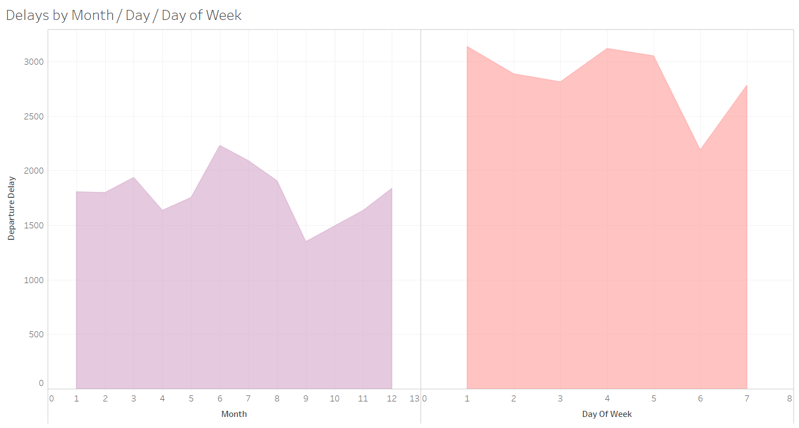
Particular months and day are correlated with Delays

Slide 9
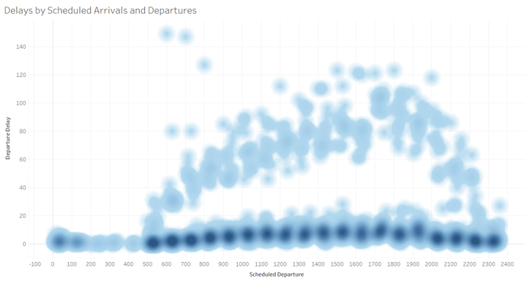
Scheduled departure time between 4pm to 10pm correlate with more delays

Slide 10
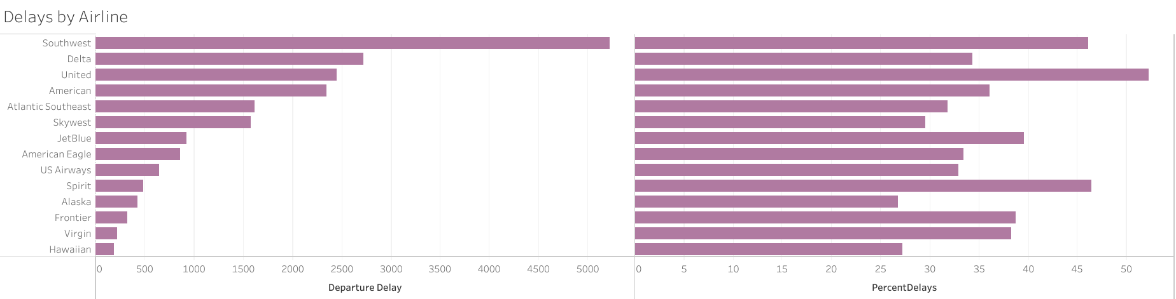
Airline companies Correlate with Departure Delays

Slide 11
Model Performance
Agreement between Training Data and Testing Data
Overall Agreement : 82% (80%)
Positive Agreement (Red): 66% (64%)
Negative Agreement (Green) : 91% (90%)
Example to show how agreements were calculated
Actual | Prediction | Agreement Between Actual and Prediction (Yes or no)
1 | 1 | Yes
0 | 0 | Yes
0 | 1 | No
0 | 0 | Yes
1 | 0 | No
1 | 1 | Yes

Slide 12
Limitations and Future outlooks
Only utilize 2015 data
Only limited to USA
Possible to serve as an aid in predicting flight departure delay for companies
May compare the accuracy across different models ( i.e random forest, deep learning)

Slide 13
Q &A
Congratulations for Graduation

